Slide 1
Tutorial 8
CREATING ELEMENT GROUPS

Slide 2
OBJECTIVES
Work with step patterns to create complex node sets
Create moded templates so that different code can be applied to the same nodes
Access node sets using ID attributes and keys
Organize elements using Muenchian grouping
Access secondary source documents

Slide 3
WORKING WITH LOCATION PATHS
Location path:
  Expression that defines a path for the processor to navigate
Default navigation direction:
  Descendants only

Slide 4
STEP PATTERNS
Allow processor to navigate node tree in different directions
Syntax: axis::node-test[predicate]
Sample: child::property[city=”Cutler”]

Slide 5
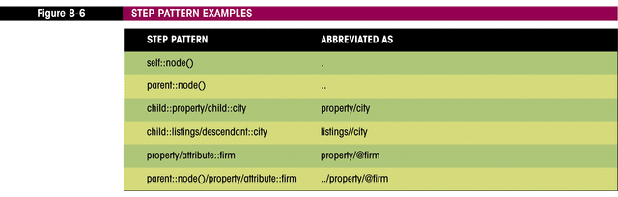
WORKING WITH AXES
13 possible values
Default is child

Slide 6
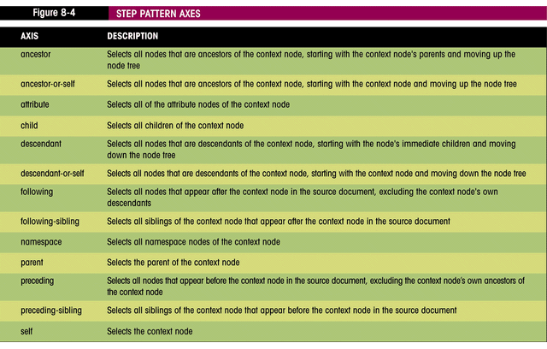
STEP PATTERN AXES

Slide 7
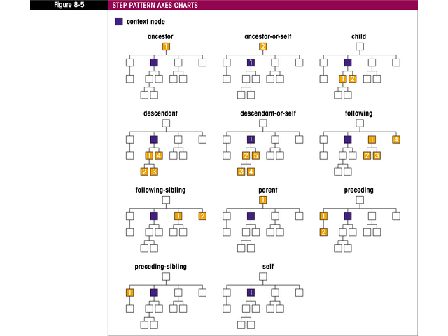
STEP PATTERN AXES CHARTS

Slide 8
ELIMINATING DUPLICATES USING STEP PATTERNS
Selecting duplicates:
  listings/property[city=preceding::property/city]
Excluding duplicates:
  listings/property[not(city=preceding::property/city)]
  <xsl:apply-templates
  select=”listings/property[not(city=preceding::property/city)]”>
  <xsl:sort select=”city”/>
  </xsl:apply-templates>

Slide 9
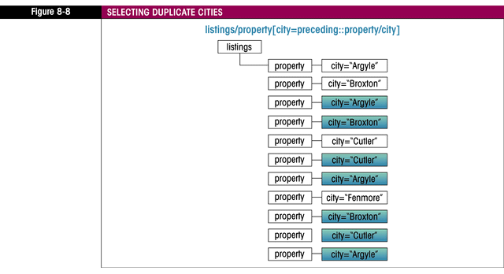
SELECTING DUPLICATE CITIES

Slide 10
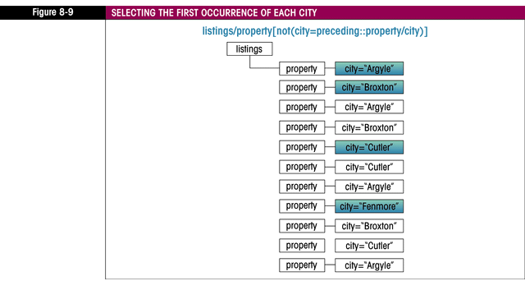
SELECTING FIRST OCCURANCE OF EACH CITY

Slide 11
CREATING MODED TEMPLATES
Apply different code to the same node set
Syntax:
  <xsl:template match=”node”mode=”mode”>
  template code
  </xsl:template>
Sample: <xsl:template match=”property”mode=”city_list”>

Slide 12
CALLING A MODED TEMPLATE
Syntax: <xsl:apply-templates select=”node-set”mode=”mode”>
Sample: <xsl:apply-templates
  select=“listings/property[not(city=preceding::property/city)]” mode=”city_list”>

Slide 13
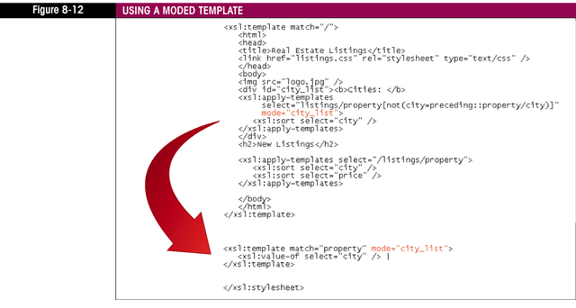
USING A MODED TEMPLATE

Slide 14
WORKING WITH IDS
Using predicates to match data:
  Sample: //property[@rln=”r317087”]
  Can be inefficient
  Processor searches document for matching node named property with specified rln attribute
  Result not stored anywhere
Using IDs and keys results in more efficient searches

Slide 15
WORKING WITH IDS
ID is declared in DTD:
  Syntax:
  <!ATTLIST element attribute ID #REQUIRED> or <!ATTLIST element attribute ID #IMPLIED>
  Sample: <!ATTLIST property rln ID #REQUIRED>
Requires the processor to verify that all attributes declared as IDs have unique values
All ID values must be unique even if they belong to different elements

Slide 16
WORKING WITH IDS
Processor creates an index of IDs
Using the id function:
  Syntax: id(value)
  Sample: id(“r317087”)

Slide 17
PROBLEMS WITH IDS
When using non-validating parser, id() function returns empty result
IDs can only be attributes
IDs must be unique across all elements
ID values must be valid XML names without spaces or special characters

Slide 18
WORKING WITH KEYS
Keys:
  Are declared in the style sheet, not in the DTD of the source document
  Have names as well as values, allowing the style sheet author to create multiple distinct keys
  Can be associated with node sets that contain attribute and element values
  Can have values that are not limited to XML names

Slide 19
CREATING A KEY
Syntax:
<xsl:key name=”name”match=”node-set”use=”expression”/>
Sample:
<xsl:key name=”rlns”match=”//property”use=”@rln”/>

Slide 20
USING KEY() FUNCTION
Syntax: key(“name”,“value”)
Sample: key(“rlns”,“r317087”)
Keys can point to more than one node

Slide 21
GENERATING IDS
Create a unique id for a node
Syntax: generate-id(node-set)
Generated ids are constrained to be:
  Same for the same node set
  Different for different node sets
Can be used to test for equality:
  generate-id($nodes1)=generate-id($nodes2)

Slide 22
GENERATING IDS
Can be used to create anchor tags:
Syntax:
  <a href=”#{generate-id(node)}”>linked text</a>
  ...
  <a name=”{generate-id(node)}”>target of link
Sample:
  <a href=”#{generate-id(@rln)}”>@rln</a>
  ...
  <a name=”{generate-id(@rln)}”>property information

Slide 23
ORGANIZING NODES WITH MUENCHIAN GROUPING
First formulated by Steve Muench of the Oracle Corporation
Uses key() and generate-id() to create groups of nodes
Usually more efficient than the use of step patterns
Worth considering when you need to organize data from a large source document

Slide 24
MUENCHIAN GROUPING
STEP-BY-STEP
Node set consists of the intersection of node1 and node2:
  node1[generate-id()=generate-id(node2)]
  property[generate-id()=
  generate-id(//property[city=”Cutler”])]

Slide 25
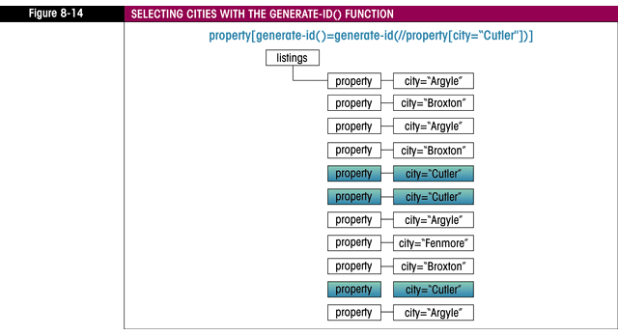
MUENCHIAN GROUPING
STEP-BY-STEP

Slide 26
MUENCHIAN GROUPING
STEP-BY-STEP
Substitute key() function for node2:
  property[generate-id()=
  generate-id(key(“cities”,”Cutler”))]

Slide 27
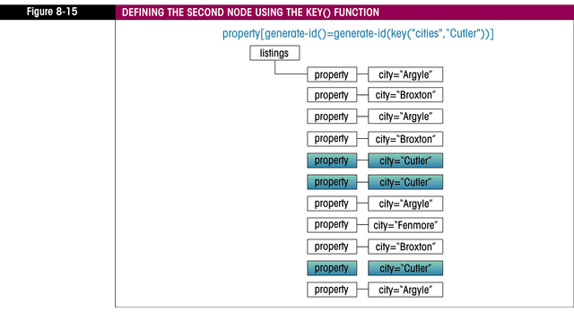
MUENCHIAN GROUPING
STEP-BY-STEP

Slide 28
MUENCHIAN GROUPING
STEP-BY-STEP
Limit node2 to one element by selecting first node only:
  key(“cities”,“Cutler”)[1]
  property[generate-id()=
  generate-id(key(“cities”,”Cutler”)[1])]

Slide 29
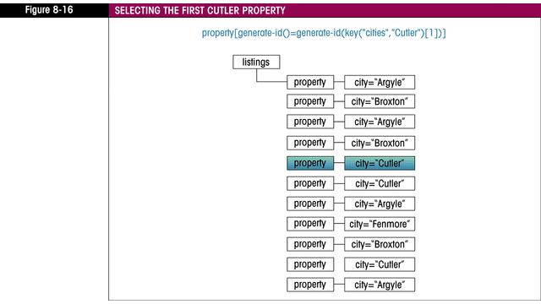
MUENCHIAN GROUPING
STEP-BY-STEP

Slide 30
MUENCHIAN GROUPING
STEP-BY-STEP
Define group for all elements, not just one:
  property[generate-id()=
  generate-id(key(“cities”,city)[1])]

Slide 31
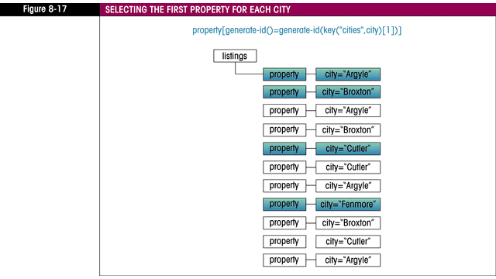
MUENCHIAN GROUPING
STEP-BY-STEP

Slide 32
USING MUENCHIAN GROUPING WITH <XSL:FOR-EACH>
<xsl:for-each select=”//property[generate-id()=
generate-id(key('cities',city)[1])]”>
<xsl:sort select=”city”/>
<h1><xsl:value-of select=”city”/></h1>
XSLT code to display information on each property
</xsl:for-each>

Slide 33
WORKING WITH MULTIPLE SOURCES
Create a reference to another source document Within a style sheet:
  Syntax: document(object,base)
  Sample: document(“firms.xml”)
Object is either:
  Xml file name
  Xml element containing file name
Base:
  Defines base URI for resolving relative references

Slide 34
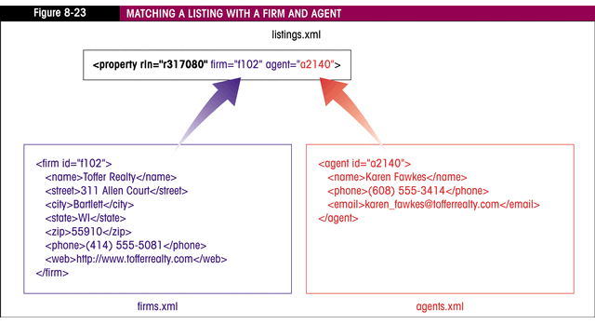
WORKING WITH MULTIPLE SOURCES

Slide 35
WORKING WITH MULTIPLE SOURCES
Referencing elements:
  document(“firms.xml”)/firms/city
Good practice:
  Create a variable for external document
  Keep track of context node
  Store values to be matched between documents in variables

Slide 36
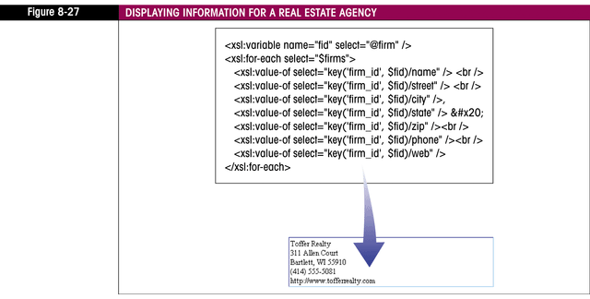
WORKING WITH MULTIPLE SOURCES

Slide 37
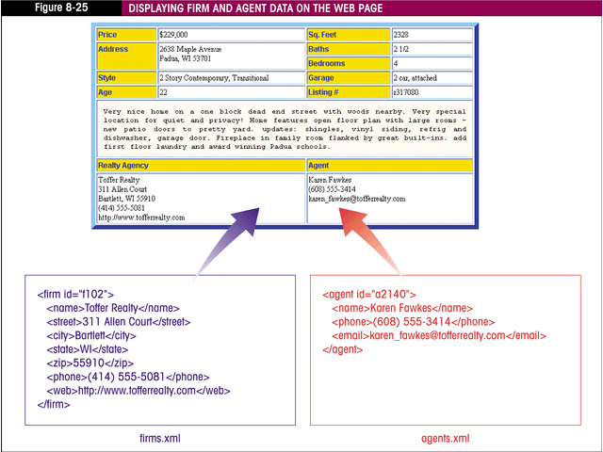
WORKING WITH MULTIPLE SOURCES

Slide 38
PLACING DATA IN A STYLE SHEET
Data can be placed directly in style sheet
Easier to manage a single file
Data should be placed in its own namespace
Data must be direct child of <xsl:stylesheet>

Slide 39
PLACING DATA IN A STYLE SHEET
Syntax:
<xsl:stylesheet version=”1.0”
xmlns:xsl=”http:/www.w3.org/1999/XSL/Transform”
xmlns:prefix=”data_namespace”
exclude-result-prefixes=”prefix”>

Slide 40
PLACING DATA IN A STYLE SHEET
Sample:
<xsl:stylesheet version=”1.0”
xmlns:xsl=”http:/www.w3.org/1999/XSL/Transform”
xmlns:data=”http://www.data_elements.com”
exclude-result-prefixes=”data”>

Slide 41
PLACING DATA IN A STYLE SHEET
To access stylesheet data:
  Syntax: document(‘’)
  Sample: document('')/xsl:stylesheet/data:agents/data:agent

Slide 42
INSERTING CODE SNIPPETS
Can be used to contain standard heading or banner
HTML code placed in XHTML file
To use:
  <xsl:copy-of select=”document('heading.html')”/>

Slide 43
SUMMARY
Step patterns can be used with location paths to search the document in different orders
Moded templates are used to define different instructions to be used with the same node pattern
IDs and keys are used to create more efficient searches
IDs can be generated using generate-id

Slide 44
SUMMARY
Muenchian grouping uses key() and generate-id() to efficiently group nodes
Multiple XML documents can be used by a stylesheet and opened with the document() function
Data can be inserted directly into the stylesheet
Code snippets can be placed in XHTML files and imported using document()

